Slide 1


CSE 455 Software Testing
Lecture 8
This course is offered to the students of students of BS Software Engineering who are enrolled in 8th semester

Slide 2
Course instructor Yella mehroze
yellamehroze@cuilahore.edu.pk

Slide 3
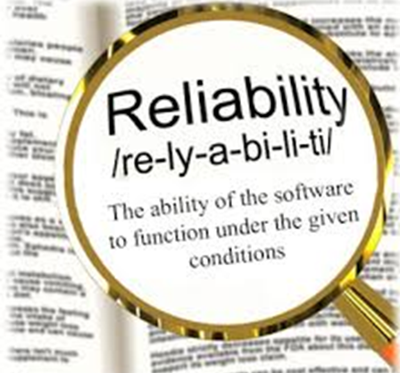
Reliability Testing
Notes:
NOTE:
To change the image on this slide, select the picture and delete it. Then click the Pictures icon in the placeholder to insert your own image.

Slide 4
Outline
Reliability
Reliability Testing
Reliability and Other Quality Factors
Reliability Testing Effect on Memory
Ways to Express Reliability Defects
Selection of Operations for Reliability
Reliability Tested Products Characteristics

Slide 5
Reliability Testing
Reliability testing is done to evaluate the product’s ability to perform its required functions under stated conditions for a specified period of time for a large no of iterations
Reliability of a product should not be confused with reliability testing

Slide 6
Reliability
The product reliability can be achieved by focusing on the following activities
Defined Engineering process
Follow clearly defined processes
Team should understand requirements for reliability from beginning
All activities (design, coding, testing, documentation) are planned considering reliability
Review of work products at each stage
Products are reviewed at the end of each stage of the product development life cycle
This ensures early detection of errors and their fixes

Slide 7
Reliability
Change management procedures
Many errors appear in the product due to improper impact analysis of changes made to the product
Changes received late can prove harmful
A clearly defined change management procedure is necessary
Review of testing coverage
Allocating time for different phases and testing types can help in catching errors
All testing activities are reviewed for adequacy, time allotted, test cases and effort spent for each type of testing

Slide 8
Reliability
Ongoing Monitoring of the product
Once the product has been delivered, it is analyzed for any possibly missed errors
The product is fixed for missed defects
This prevents the same types of defects from reappearing

Slide 9
How Reliability Testing is performed
Performing reliability testing does not ensure a reliable product as there are various other factors to be considered
At beginning, a criteria is set to allow maximum no of defects
Newly found defects are compared with previously found and analyzed for why they were not caught earlier
Defects tracked to determine the feasibility of release of the software
Defects found are compared with criteria

Slide 10
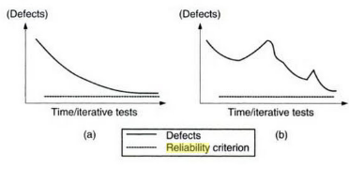
Reliability Criteria Showing Smooth Progress and Spikes

Slide 11
Reliability Testing
Spikes indicate that defect fixing is creating new defects
Action is taken to avoid spikes both from the process and product perspective to meet reliability criteria

Slide 12
Reliability and Other Quality Factors
Reliability should not be achieved at cost of some other quality factor
Collecting and analyzing the data of reliability testing should also include other quality factors to analyze the impact in a holistic manner
Reliability testing brings out those errors which arise because of certain operations being repeated

Slide 13
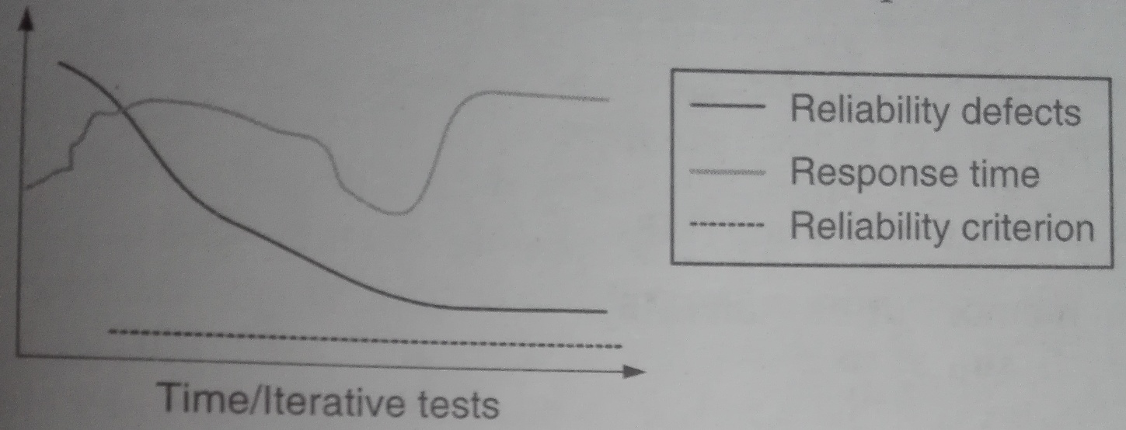
Reliability Impact on Performance

Slide 14
Reliability Testing Effect on Memory
At the end of repeated operations
The CPU may not get released
Disk and network activity may continue
Collect data regarding various resources used in the system before, during and after reliability test execution and analyze the results
Upon reliability test completion, the resource utilization should drop down to the pre-test level of resource utilization
Memory problems are common among most server software errors

Slide 15
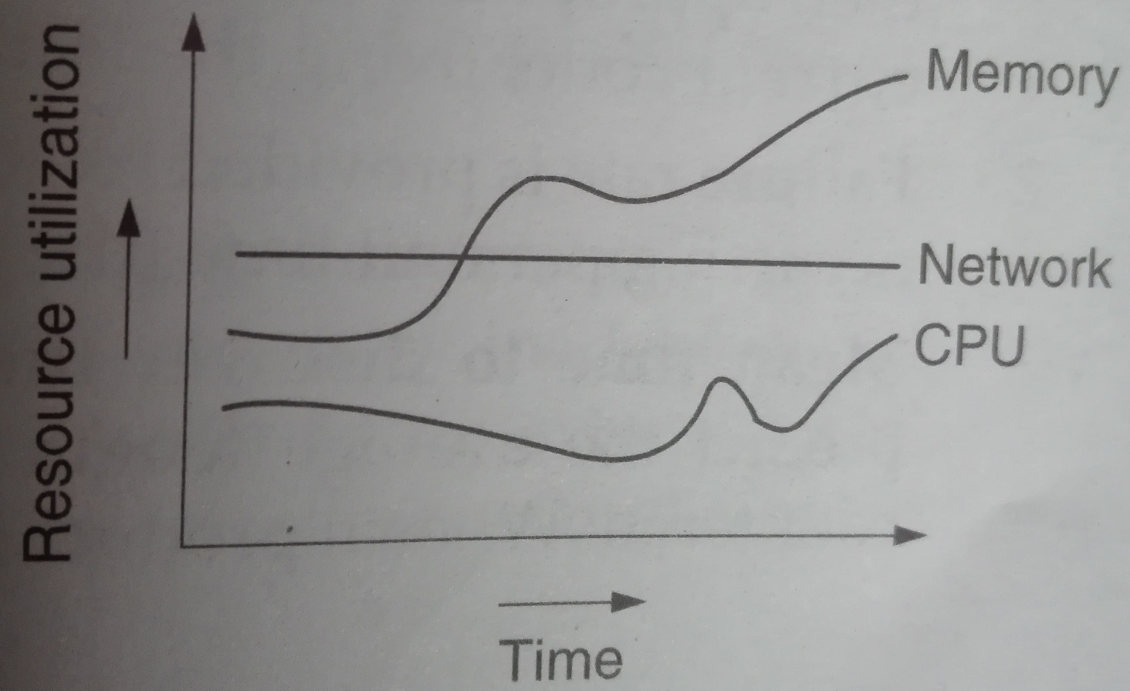
Resource Utilization Over a Period of Time the Reliability Tests are Executed

Slide 16
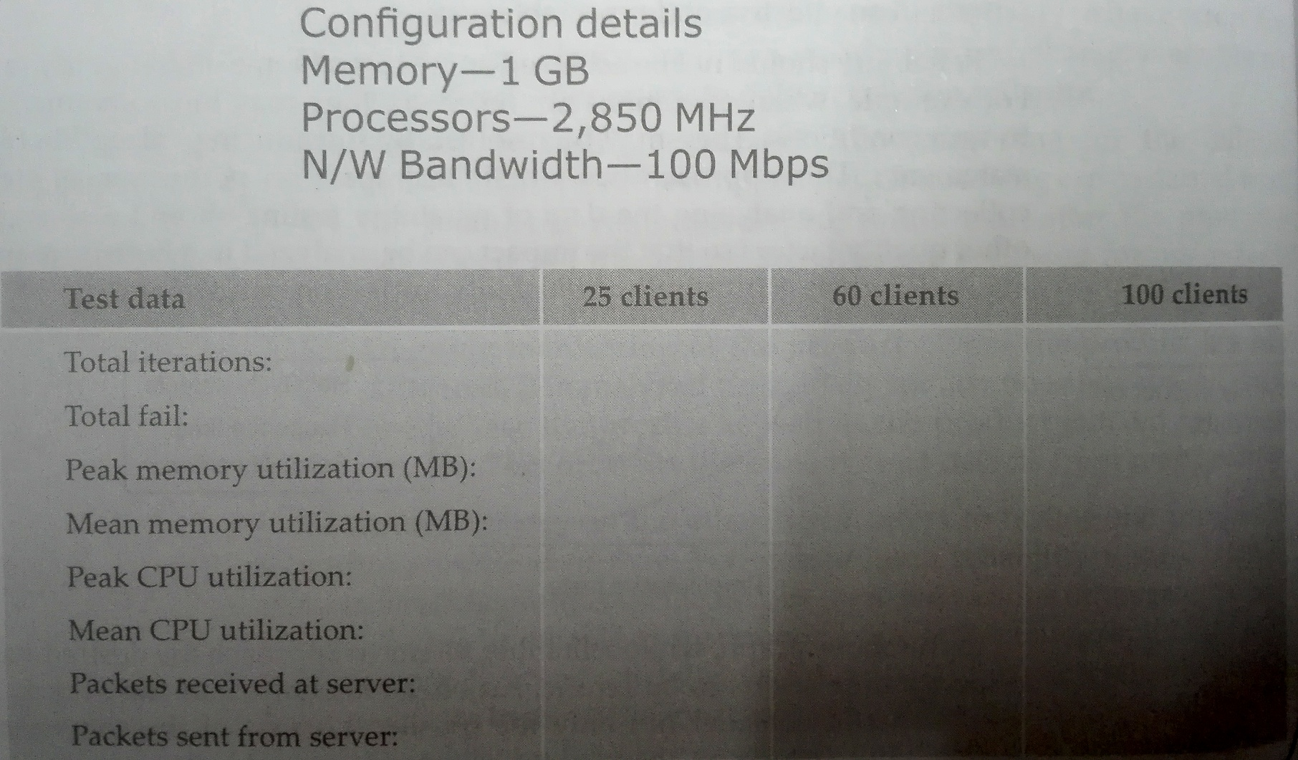
Table giving an idea on collection of reliability data

Slide 17
Ways to Express Reliability Defects
Mean Time Between Failures- Average time elapsed from between successive product failures
The details on the time a product fails need to be maintained to understand its reliability for a specified time frame.
For example, if the product fails, say, for every 72 hours, then appropriate decisions may have to be taken to correct code, fixing the issue, and then deploying the same.
Failure Rate- is provided as a function that gives the number of failures occurring per unit time
Mean Time to Discover the Next K Faults- is the measure used to predict the average length of time until the next K faults are encountered
When the product is unstable, the time taken to find K faults will be less
When the product becomes more stable, the time taken to find K faults will be increased

Slide 18
Selection of Operations for Reliability
All operations need not to be repeated
Configuration, restore and back up operations are rarely performed and should not be selected for reliability
Highly and most frequently used operations should be considered for reliability testing
Operations that reflect customer daily activities should be considered for testing
For example login and logout operations are important operations that need to be reliability tested
Scenarios closer to the real usage of the product should be selected for testing

Slide 19
Reliability Tested Products Characteristics
No errors or very few errors from repeated transactions
Zero downtime
Optimum utilization of resources
Consistent performance and response time of the product for repeated transactions for a specified time duration
No side-effects after the repeated transactions are executed

